Slide 1
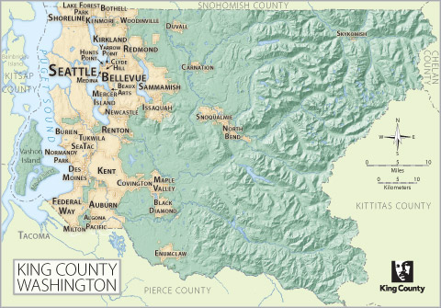
Linear Regression Modeling King’s County Housing

Slide 2
The Data
Target:
Goal is to predict: House Price
Predictor Variables:
Number of Bedrooms, Bathrooms, and Floors
Sq. footage – Internal and Lot
Overall Condition (1-5)
Geographical Location (Based on Clustering)
Waterfront (yes / no)
Year Built
Renovated (yes / no)

Slide 3
DATA
Feature Engineering
Build Model
Deploy!
Test
Model
Bad Results
Good Results

Slide 4
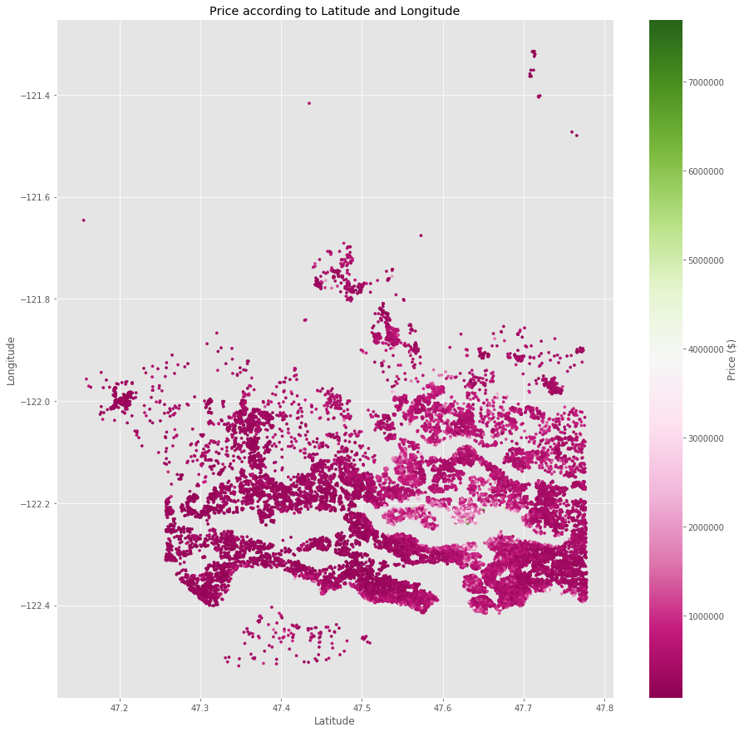
Problem: Dealing with Location Data
Price depends on exact location
Difficult to use latitude, longitude, zip code in linear model
Still want to capture affect of location in model

Slide 5
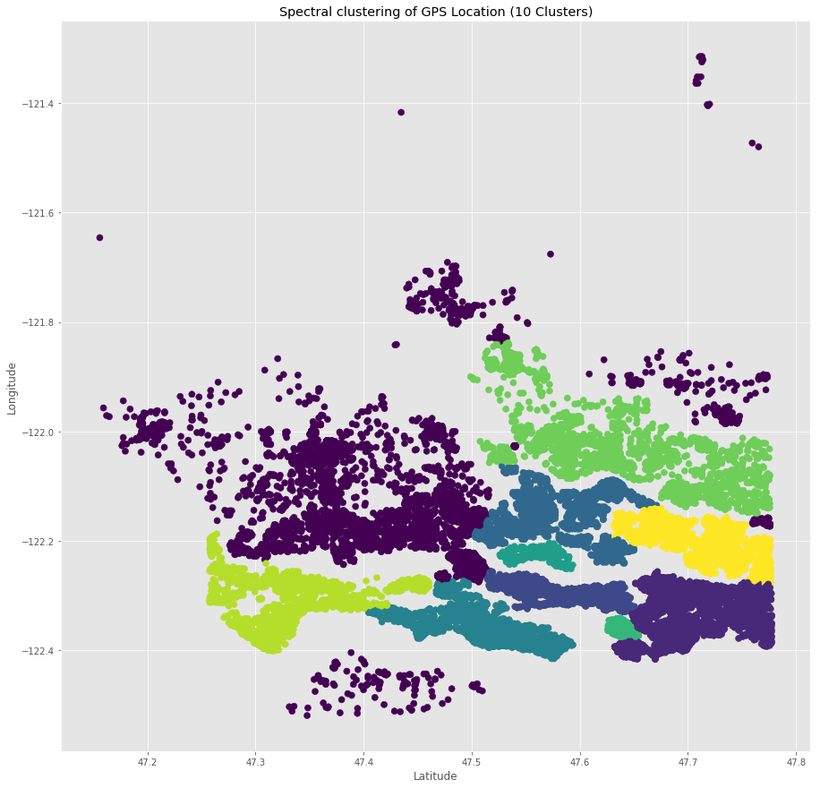
Solution: Spectral Clustering
Finds patterns in data and separates into groups
Works well with complicated patterns
Gives good way to distinguish geographical affect of price
Works well in linear model

Slide 6
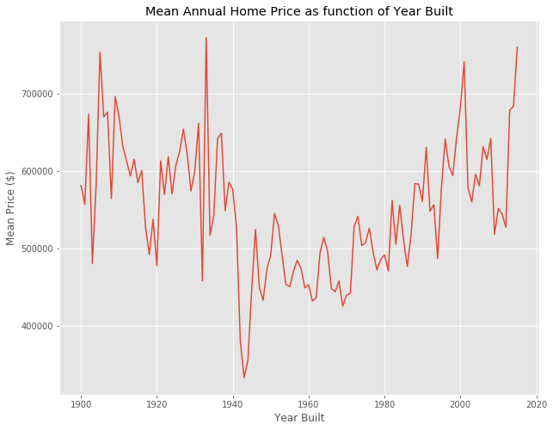
Problem: Dealing with time series data
Year built has clear affect on price
Won’t work well in linear model
Still want to capture affects in linear model

Slide 7
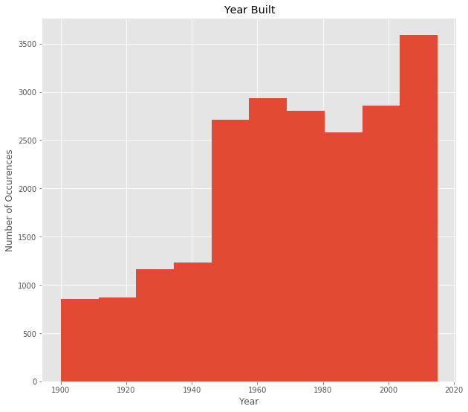
Solution: Binning
Reduce complexity: Keep only which decade house belongs to
Create new features representing each bin
Linear model captures time affect – Performs better

Slide 8
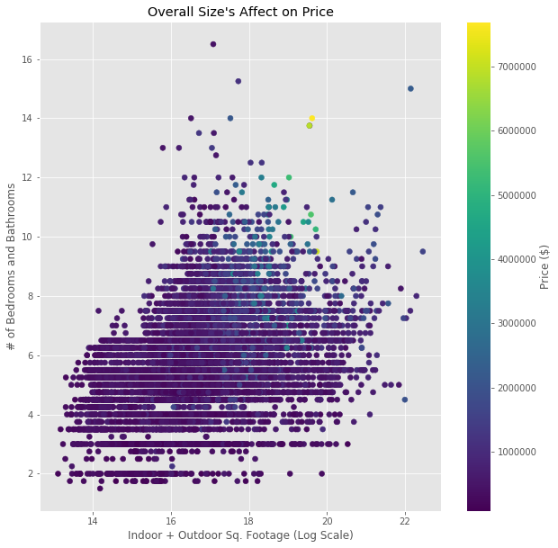
The Model
Best Features:
Number of Total Rooms
Indoor + Outdoor Sq. Footage
Location
Year Built
Achieved R^2 Score of
~0.70 on Test Set
~0.76 on Training Set
Results:
Housing prices are volatile, so these results are good for a linear model
(See how spread out visual is)

